Slide 1
SAP EWM EXTENDED WAREHOUSE MANAGEMENT TRAINING
AnubhavTrainings.com

Slide 2

SAP EWM TRAINING
BY:- Mr.Bijoy
www.anubhavtrainings.com
Notes:
https://unsplash.com/photos/uXB-7la5vqA

Slide 3
SAP EWM TRAINING (Day 1)
AnubhavTrainings.com

Slide 4


DISCLAIMER
The training content and delivery of this presentation is confidential, and cannot be recorded, or copied and distributed to any third party, without the written consent of Anubhav Trainings.
www.anubhavtrainings.com

Slide 5
Overview of SAP EWM
01
SAP WM Overview
Introduction to SAP EWM
04
02
Deployment options
05
Difference between EWM & WM
03
Embedded & De-centralized EWM

Slide 6

S4hana Ewm Server Access Details
On your desktop
start>run>type mstsc >enter ip add : 183.82.120.214:4224 > connect

Slide 7
Overview of SAP EWM
01
SAP WM Overview
Introduction to SAP EWM
04
02
Deployment options
05
Difference between EWM & WM
03
Embedded & De-centralized EWM

Slide 8
Agenda (Overview of Course)
1
6
Overview of SAP EWM
HU Management
2
7
Resource Management & Warehouse Monitor
SAP EWM Business processes
3
8
Packaging Specification
& PPF Actionsc
SAP MM & EWM Org Structure
4
9
ERP S4 - EWM Integration & EWM Master data
Internal Processes & Work center
5
10
Inbound Process / Putaway Process
Outbound Process / Stock Removal Process
www.anubhavtrainings.com

Slide 9
Agenda (Overview of Course)
11
16
WOCR & Wave Management
Yard Management
12
17
Physical Inventory
VAS (Value added serviceNumber
Managements)
13
18
Batch Management in EWM
& Exception Codes
ST Type controls & Mass upload
14
19
Cross Docking
POSC (Process Oriented Storage control)
15
20
LOSC (Layout Oriented Storage control)
Transfer Posting from ERP side to
side & EWM to ERP side
www.anubhavtrainings.com

Slide 10
Agenda (Overview of Course)
21
Bulk Storage Strategy
22
Revision of Topics
23
Revision of Topics
www.anubhavtrainings.com

Slide 11

Introduction
SAP Extended Warehouse Management (EWM) is used
to efficiently manage inventory in the Warehouse and
for supporting processing of goods movement.
It allows the company to control their Warehouse
inbound and outbound processes and movement
of goods in the Warehouse.
Notes:
You can safely remove this slide. This slide design was provided by SlideModel.com – You can download more templates, shapes and elements for PowerPoint from http://slidemodel.com

Slide 12
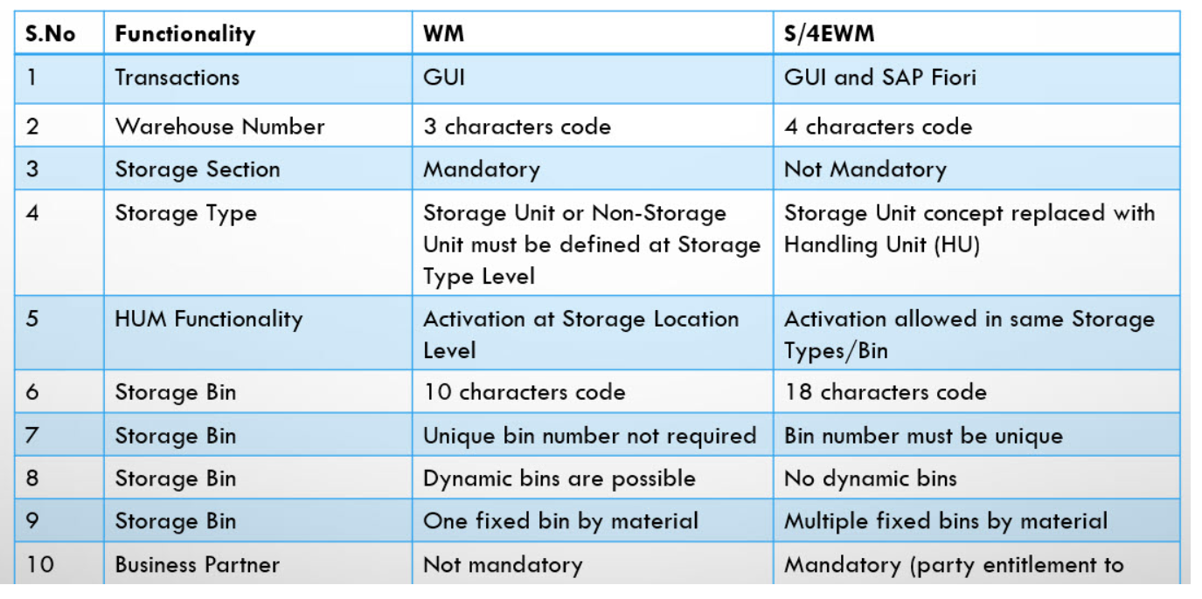
How is it different from WM

Slide 13
Key Features
You can perform deconsolidation of handling units which contain different products before putting them away in different storage sections.
It allows you to perform executable tasks like work packages, consisting of warehouse tasks warehouse employees should perform as part of warehouse management activities.
It allows you to manage track vehicles and transportation units from yard check-in to yard checkout, including movements’ tasks within the yard.
Provides use of activity areas, resource management, transportation management, perform deconsolidation, etc.
Warehouse activity can be monitored in warehouse monitor.
www.anubhavtrainings.com

Slide 14
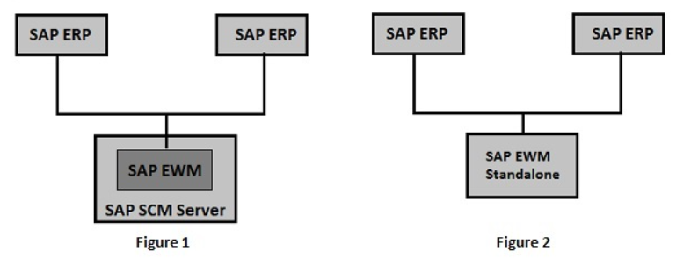
Deployment option
Figure 1 : Decentralised EWM
Figure 2 : Embedded EWM
www.anubhavtrainings.com

Slide 15
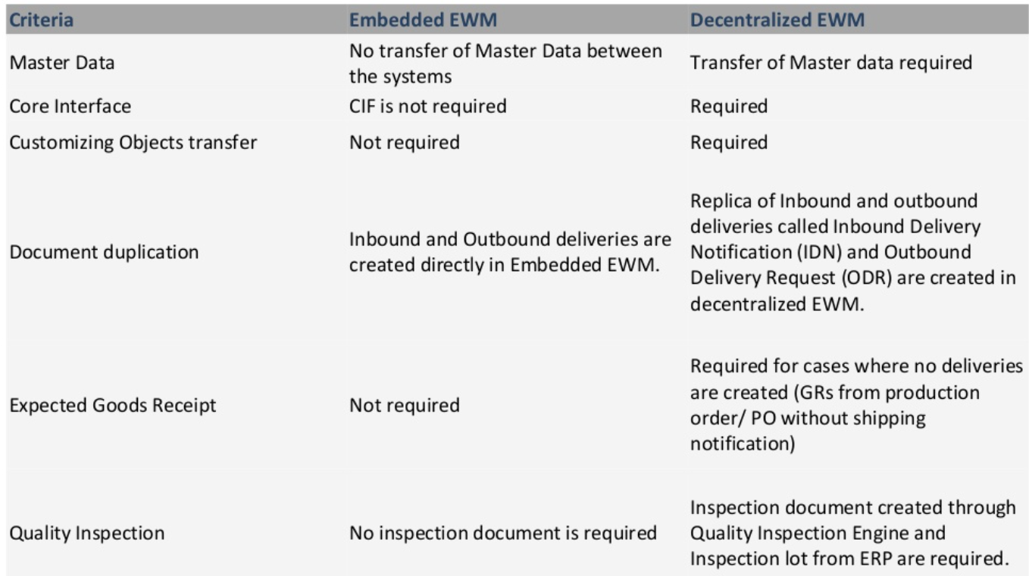
Difference between decentralized & embedded
www.anubhavtrainings.com

Slide 16
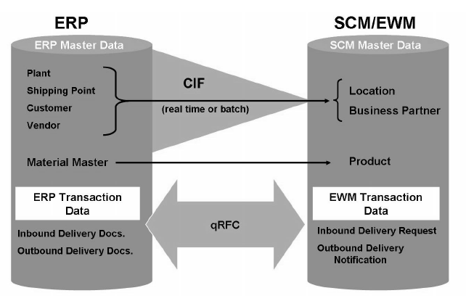
CIF
www.anubhavtrainings.com

Slide 17
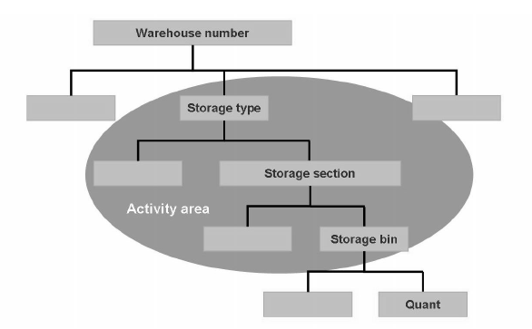
Org Structure

Slide 18
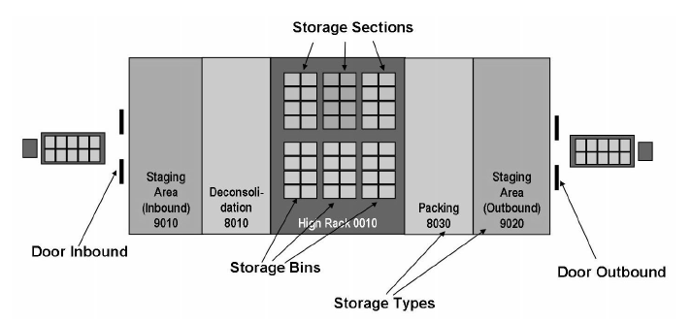
How does a warehouse looks in EWM
www.anubhavtrainings.com

Slide 19





High Rack Warehouse
www.anubhavtrainings.com

Slide 20

Open Warehouse
www.anubhavtrainings.com

Slide 21
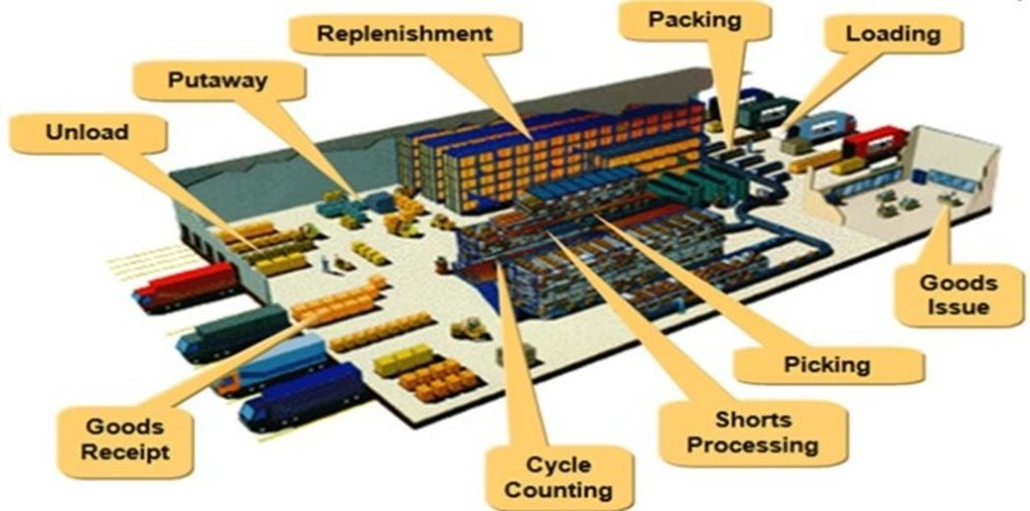
Warehouse Activities
www.anubhavtrainings.com

Slide 22
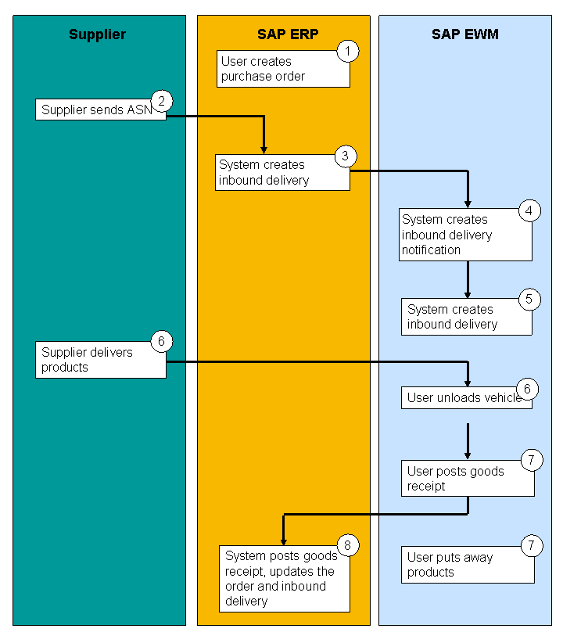
Inbound Process
www.anubhavtrainings.com

Slide 23
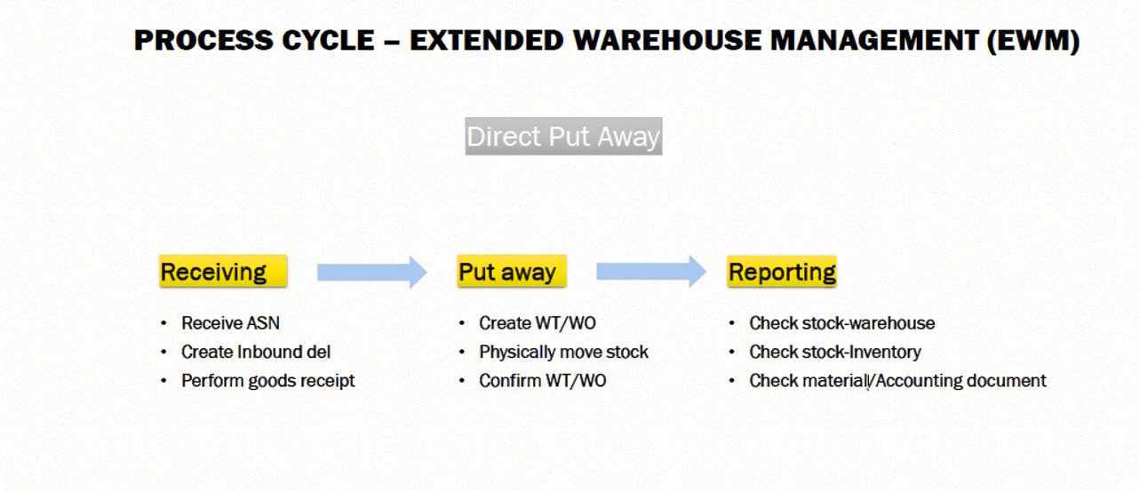
Inbound Cycle
www.anubhavtrainings.com

Slide 24
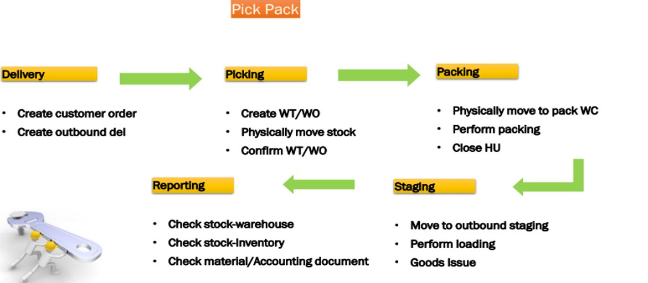
Outbound Process
www.anubhavtrainings.com

Slide 25

End of Session 01

Slide 26

FEEL FREE TO ASK QUESTIONS

Slide 27

Feedback

Slide 28
THANK
YOU

Slide 29




More from AnubhavTrainings.com

Slide 30






We’re committed to empower you to be
#FutureReady
through powerful training solutions.
We build the workforce of the future.
250+
Corporate Clients
30,000+
Learners Trained
25000+
Learners Placed
FREE WEBINARS
Sign up for free webinars with industry experts every fortnight!
Enroll Now!
Contact us today!
www.anubhavtrainings.com

Slide 31
FREE WEBINARS
Sign up for free webinars with industry experts every fortnight!
Contact us today!
www.anubhavtrainings.com

